Slide 1
Customer Retention Case Study
EDA

Slide 2
E-retail factors for customer activation and retention: A case study from Indian e-commerce customers
Customer satisfaction has emerged as one of the most important factors that guarantee the success of online store; it has been posited as a key stimulant of purchase, repurchase intentions and customer loyalty. A comprehensive review of the literature, theories and models have been carried out to propose the models for customer activation and customer retention. Five major factors that contributed to the success of an e-commerce store have been identified as: service quality, system quality, information quality, trust and net benefit. The research furthermore investigated the factors that influence the online customers repeat purchase intention. The combination of both utilitarian value and hedonistic values are needed to affect the repeat purchase intention (loyalty) positively. The data is collected from the Indian online shoppers. Results indicate the e-retail success factors, which are very much critical for customer satisfaction.

Slide 3
Be careful:
There are two sheets (one is detailed) and second is encoded in the excel file. You may use any of them by extracting in separate excel sheet. The number of column(s) is more than 47. Read the column header carefully. Note : Data Scientists have to apply their analytical skills to give findings and conclusions in detailed data analysis written in jupyter notebook .
Only data analysis is required.

Slide 4
About Data Set
Number of rows and columns in given Data Frame is (269, 71).
All features consists of questions, on which customer response is recorded.
We will see detailed, description/meaning of features in EDA.
There are 166 duplicate values in Data Set.
Duplicates doesn't play any role in analysis, unique values must be considered for processing.
To save time, processing power, Cost - these duplicates must be dropped
After dropping duplicates, we have 103 records.
Total 269 - 103 = 166 Duplicate values
Around 61% of our values are same.
Only 103 unique values remained

Slide 5
About Data Set
There is only one Numerical feature, i.e. Pin Code. It is representation of city/village. So we can treat it as categorical feature.
After considering it as categorical feature, out data set contains all Categorical Values.
There are total 0 missing values in dataset

Slide 6
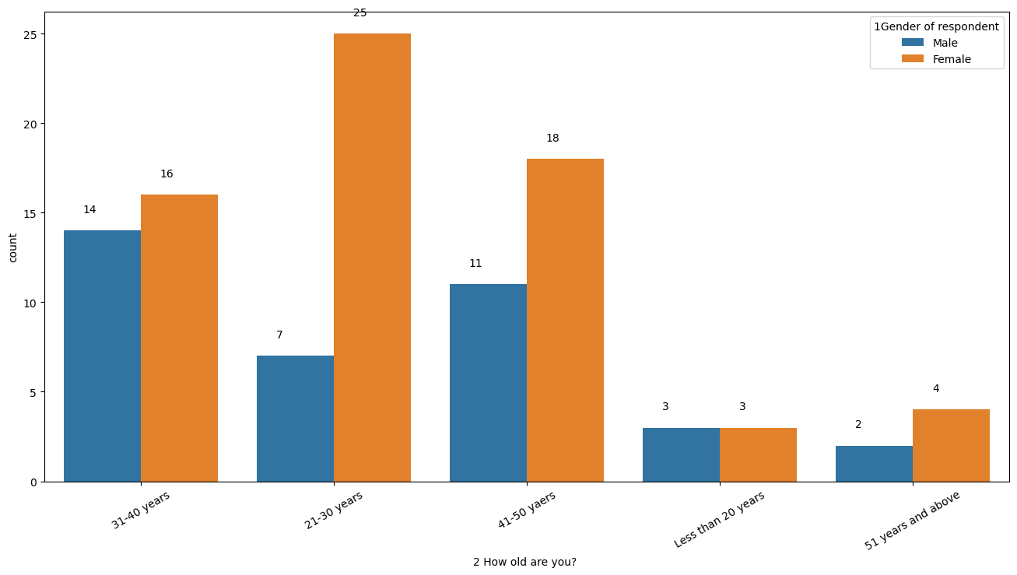
EDA
Count Plot – “Gender of Response” vs “How old are you?”.
There are more customer in age group 21-30.
From all age groups, Females are shopping more than men.

Slide 7
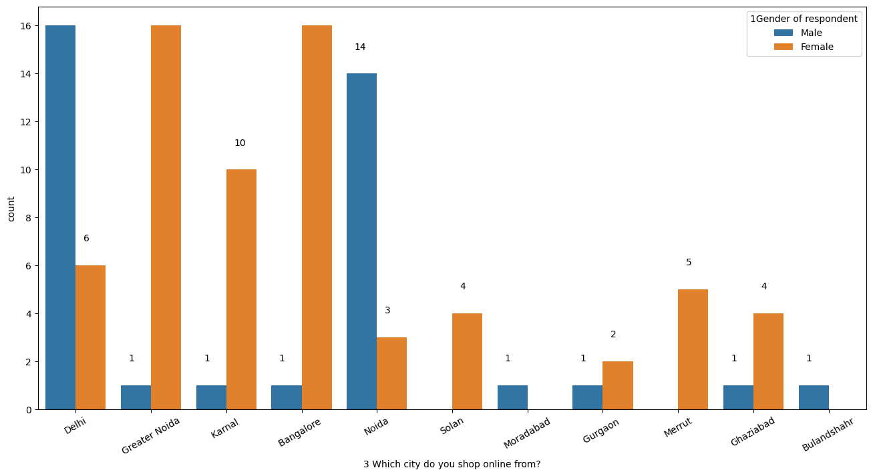
EDA
Count Plot – “Gender of Response” vs “Which city do you shop online?”.
In Delhi and Noida – There are more male customers than females.
But in Bangalore and Greater Noida – There are more female users using online shopping.

Slide 8
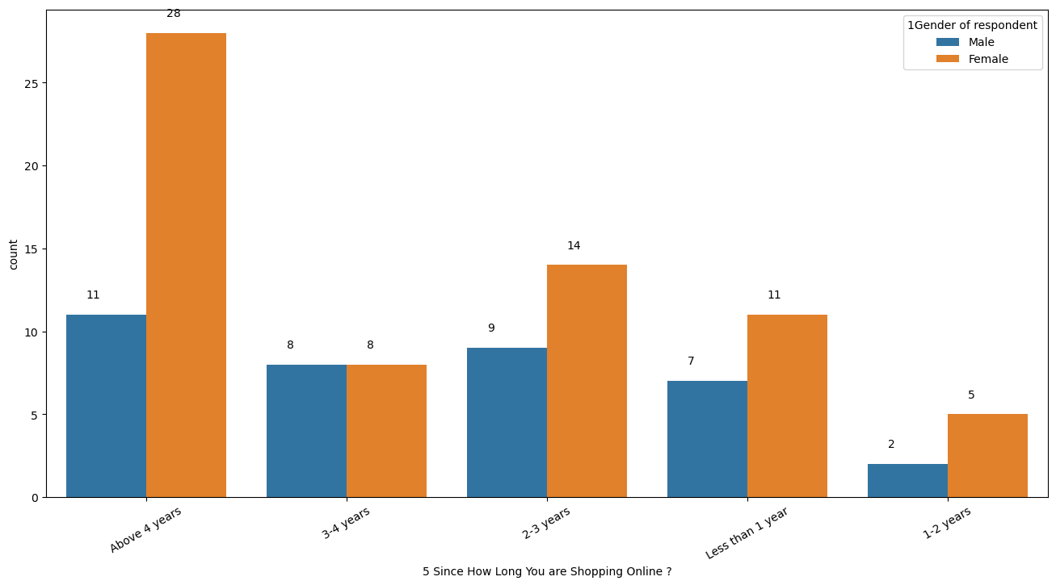
EDA
Count Plot – “Gender of Response” vs “5 Since How Long you are Shopping online?”
Around 39 customer are using online shopping from last 4 years.
More customer are using online shopping from past 0-3 years.

Slide 9
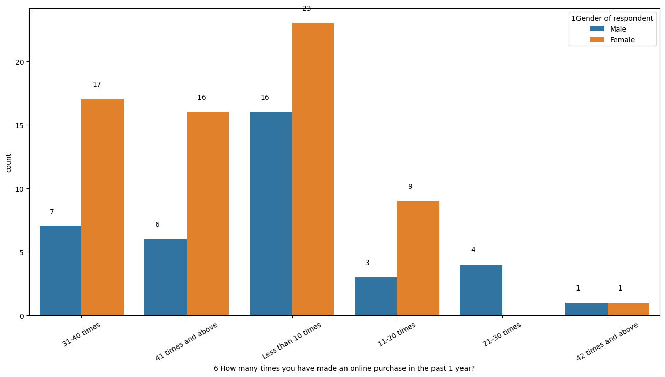
EDA
Count Plot – “Gender of Response” vs “How old are you?”.
From graph it is clear that females are more likely to purchase online.
Rate of purchase of females is more. Around 33 females are purchasing more than 30 times in year.
Whereas, men’s are more likely to purchase less than 10 times.
Still females are using online shopping.

Slide 10
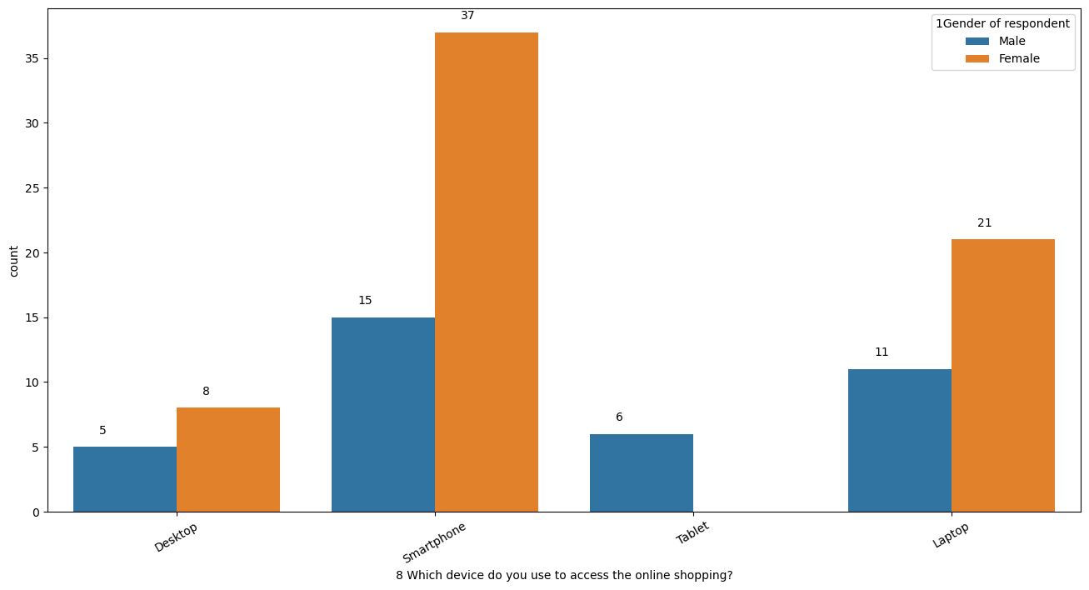
EDA
Count Plot – “Gender of Response” vs “How old are you?”.
Most of the customer are using “Smartphone” for ordering.

Slide 11
EDA
Count Plot – “Gender of Response” vs “How old are you?”.
There are more customer in age group 21-30.
From all age groups, Females are shopping more than men.

Slide 12
Conclusion
It is important to focus on Female group, as there are more female customers.
From my POV, it is important to focus on improving mobile shopping experience, as more people are using mobile phone for ordering/searching.

